Slide 1
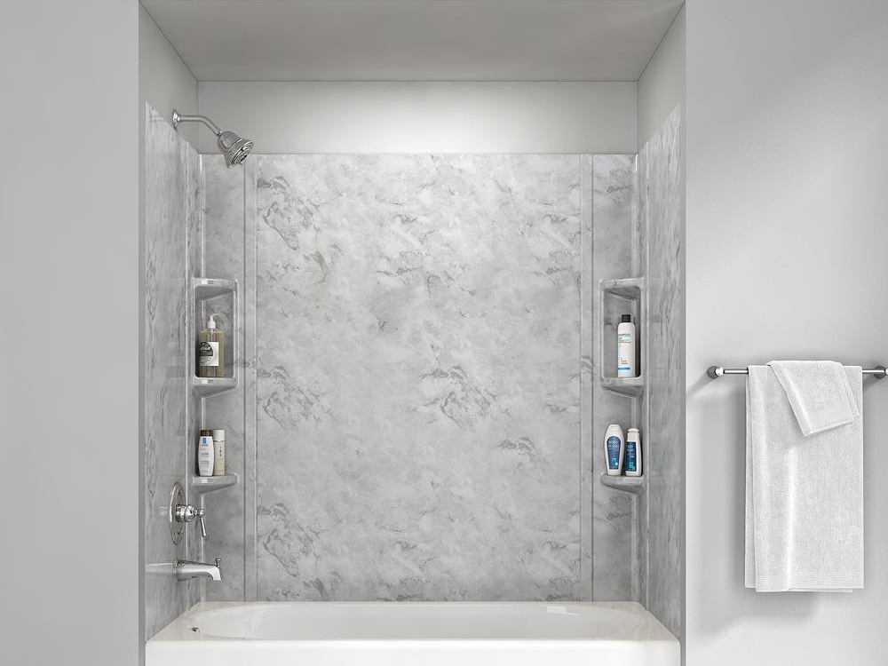

70° F|C
84 ° / 65 °
Humidity: 57%
08:09 AM
Friday, October 18, 2019

Slide 2

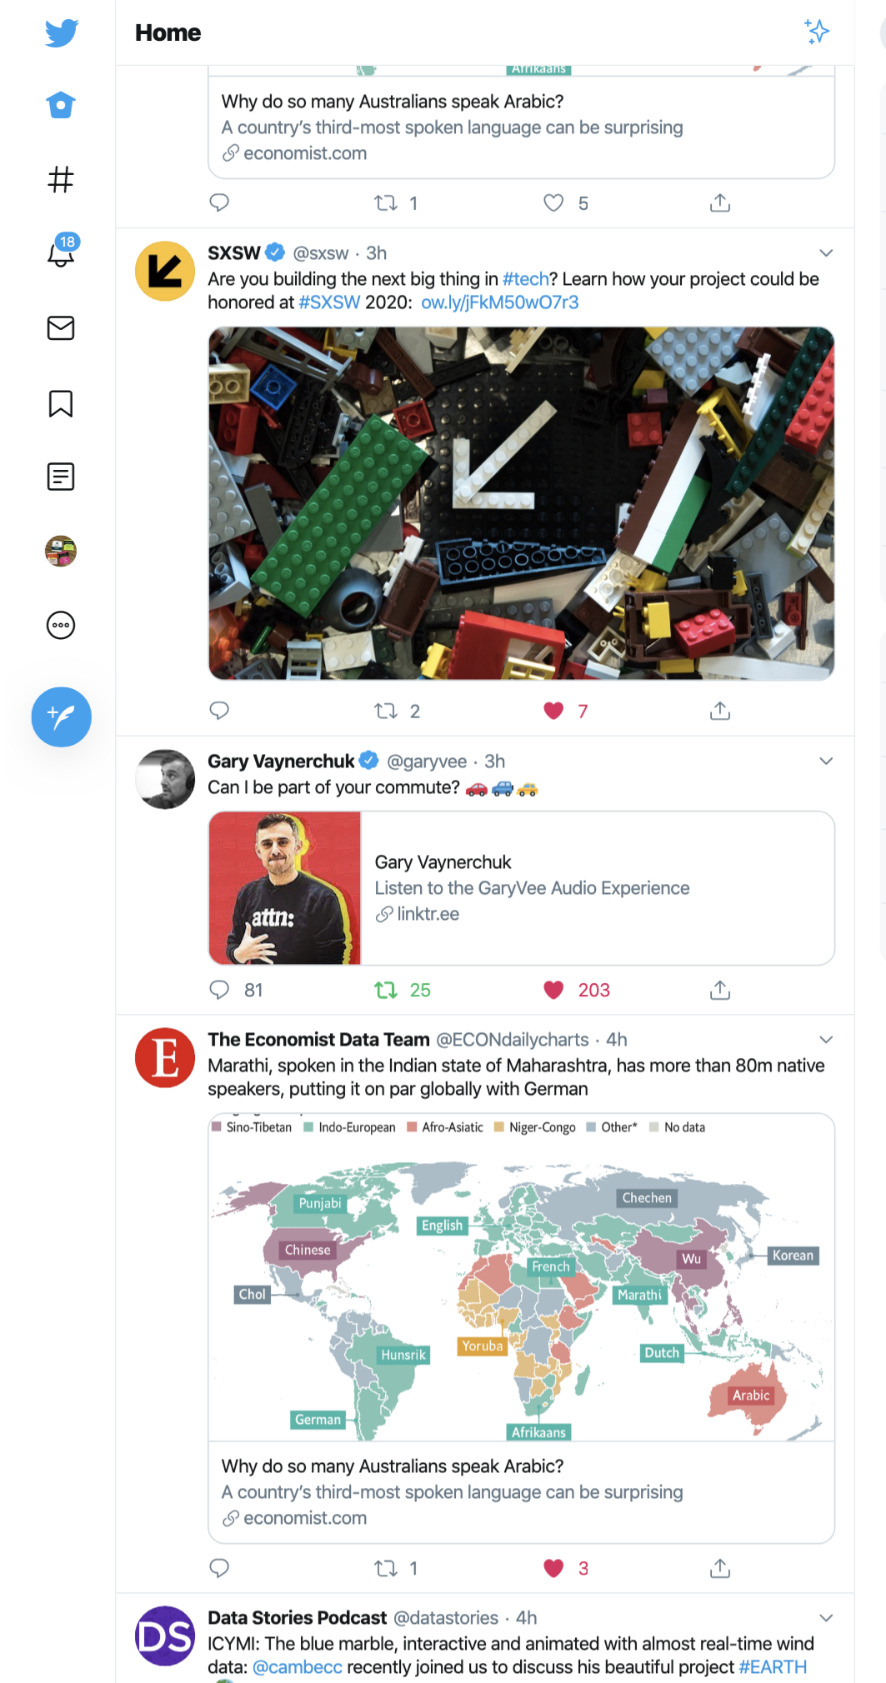
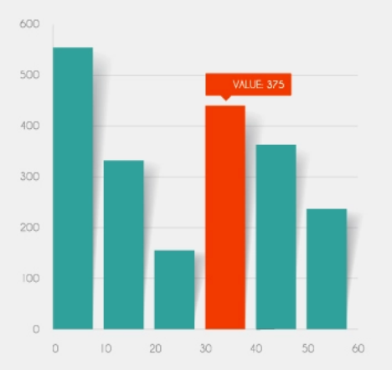
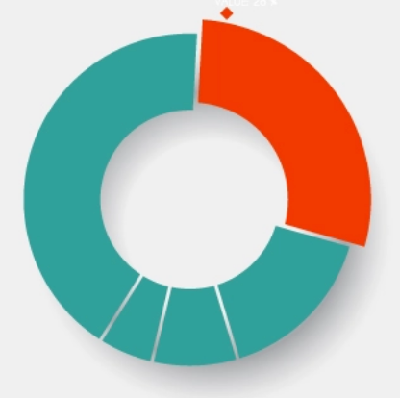
70° F|C
84 ° / 65 °
Humidity: 57%
08:10 AM
Friday, October 18, 2019
Good morning, Alex!
Upcoming events
Exercise | 8:30 - 9:00 AM
Work | 9:30 - 11:45 AM
Lunch | 12:00 - 12:45 PM
Sleep hours
Steps per day

